Slide 1



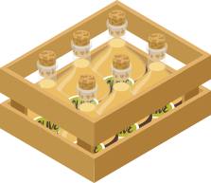




HARVEST
HUB
BY FARMERS FOR FARMERS
St1516
Name: ryan yeo
Class: DAAA/FT/2B/01
aDMIN NUMBER: P2214452

Slide 2
Table of contents
1.
Application
2.
Devops Process
3.
Testing
4.
Advanced
Robotic Process Automation
5.
6.
References

Slide 3
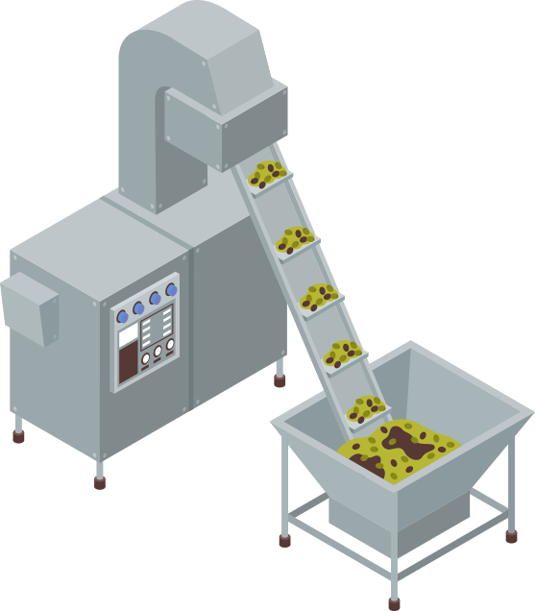
1.
APPLICATION

Slide 4
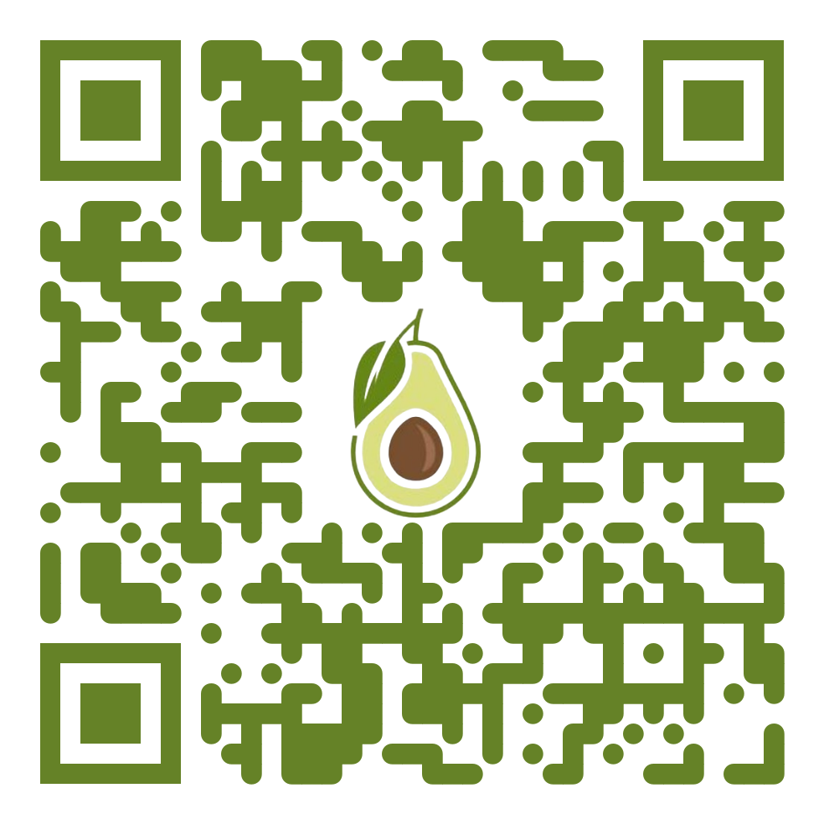
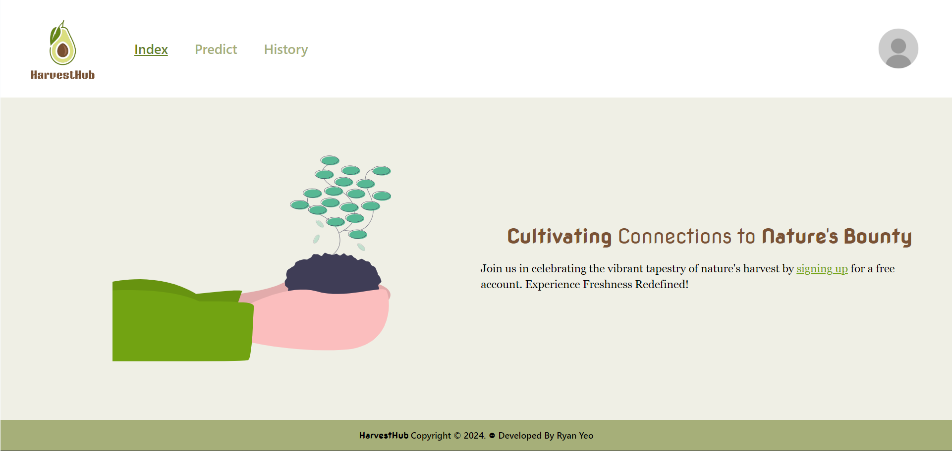
APPLICATION

Slide 5
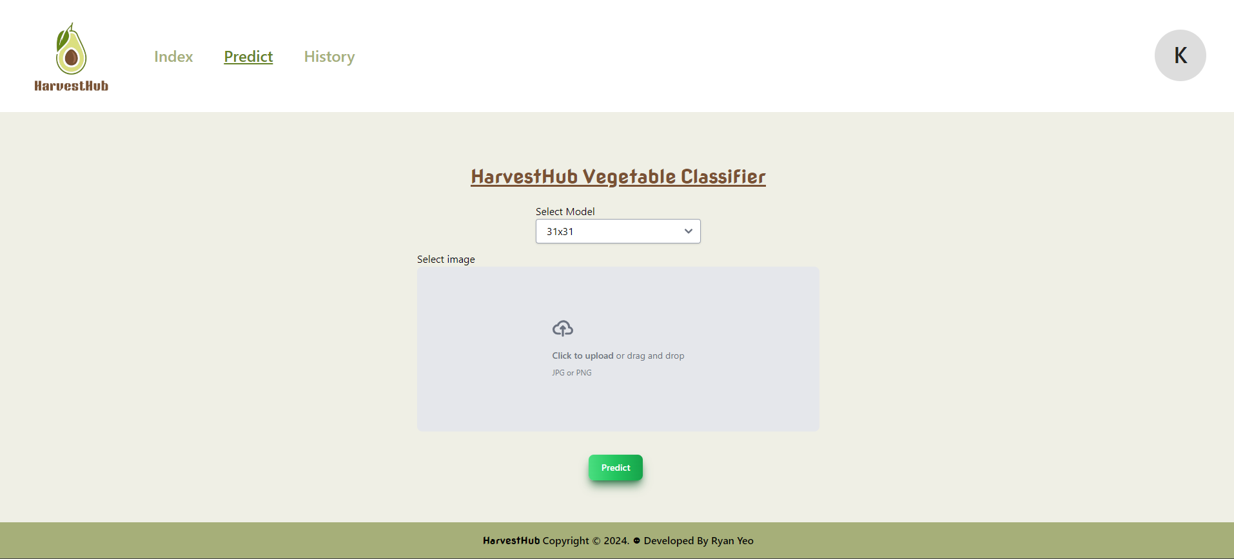
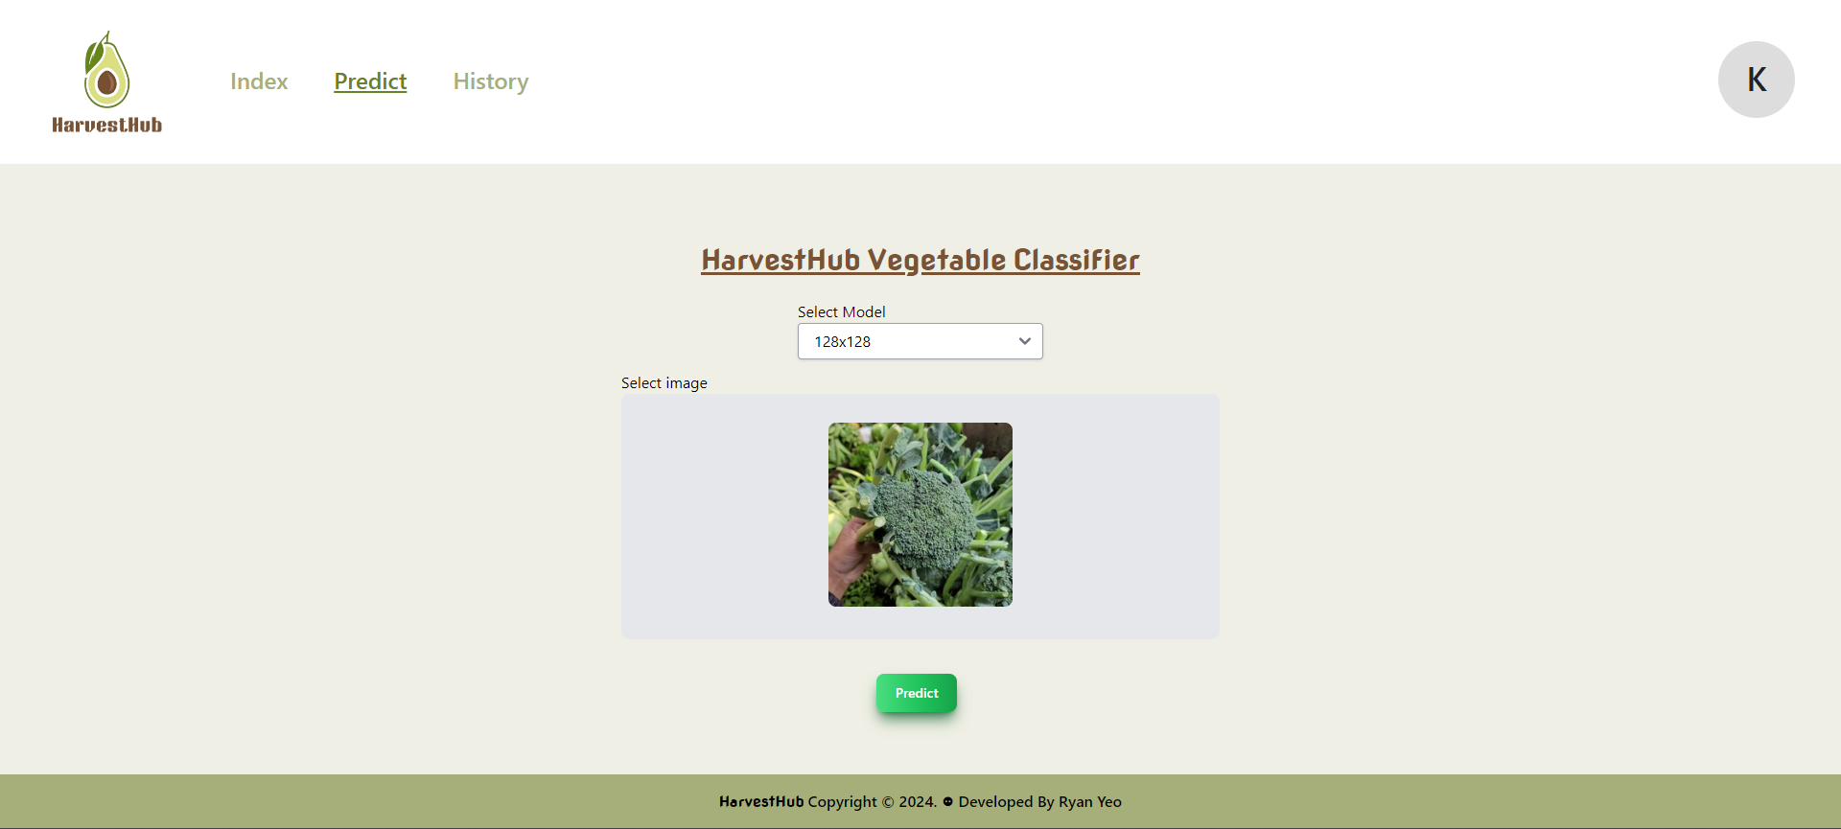
Prediction Page
Choose between 31x31 and 128x128 model
Input Image to be classified as 1 of 15 vegetable classes

Slide 6
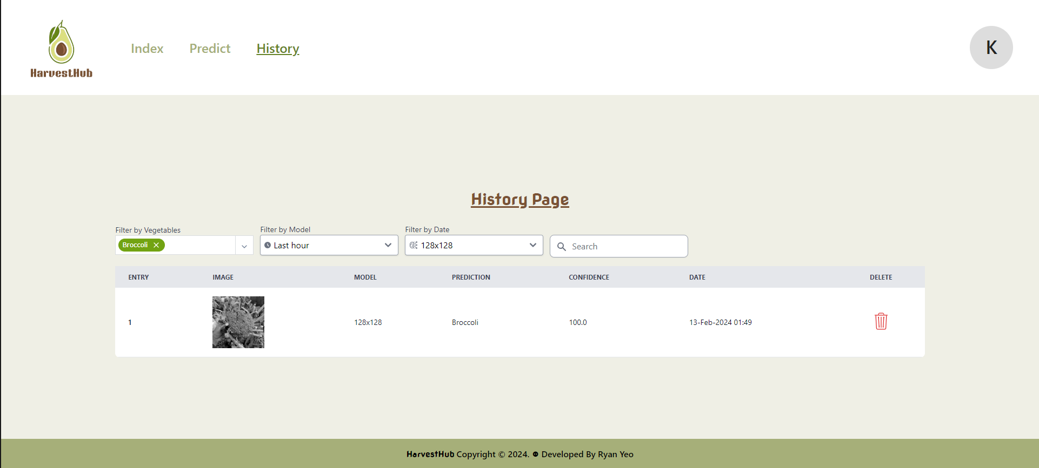
History Page
Display Predictions made by user
Filter by:
Vegetable (MultiSelect)
Date
Model
Search Bar (any column)

Slide 7
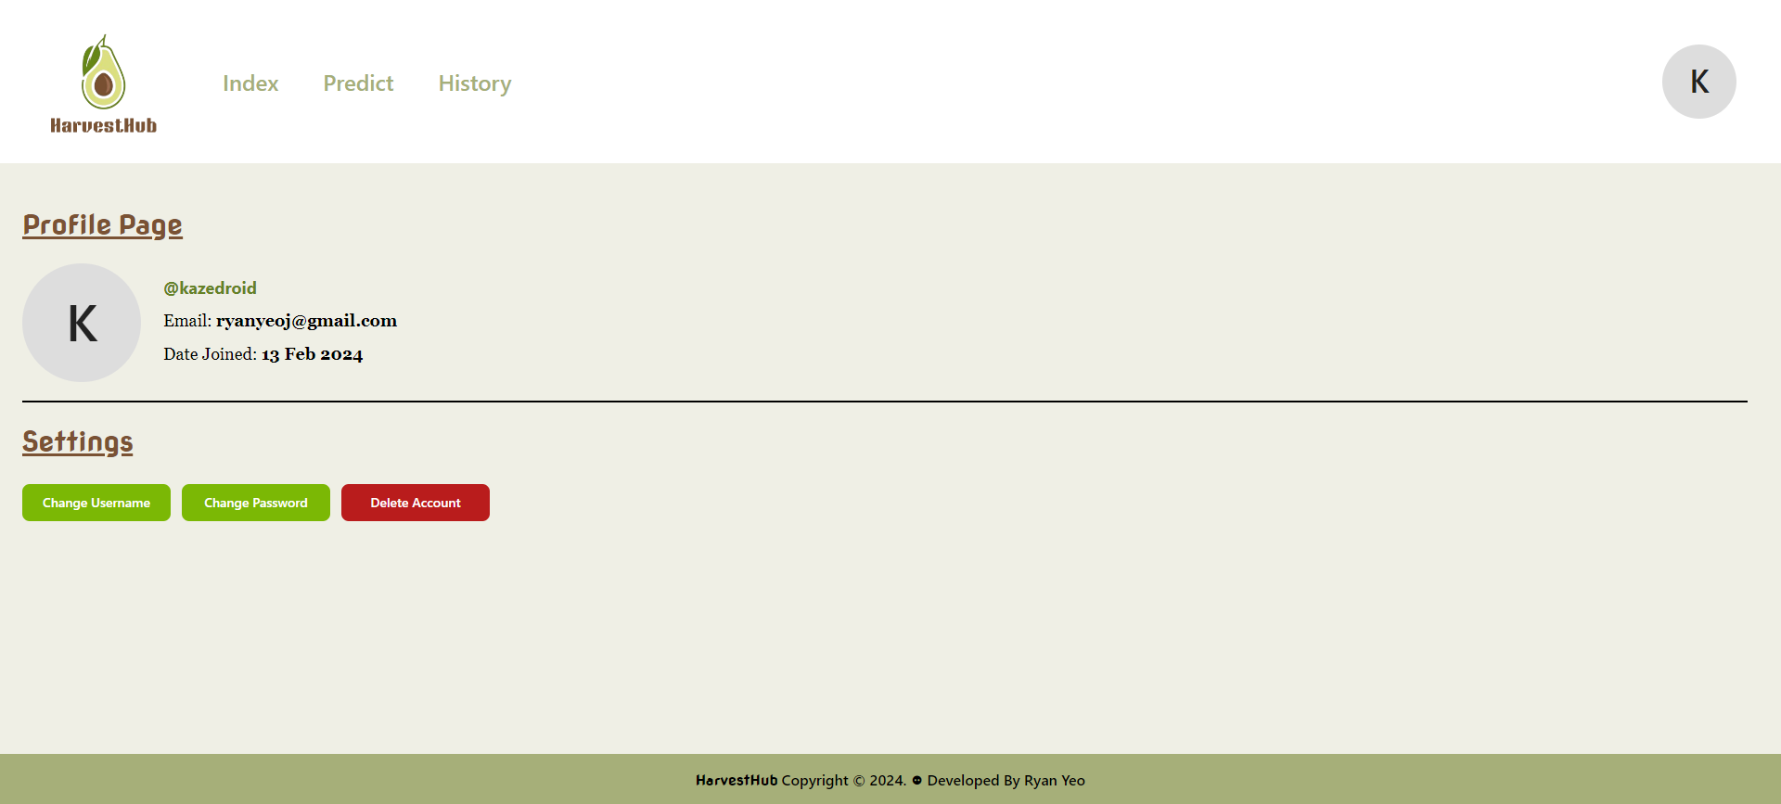
Profile Page
Display username, email and date joined
Allow user to change username, change password and delete account

Slide 8
2.
Devops process

Slide 9
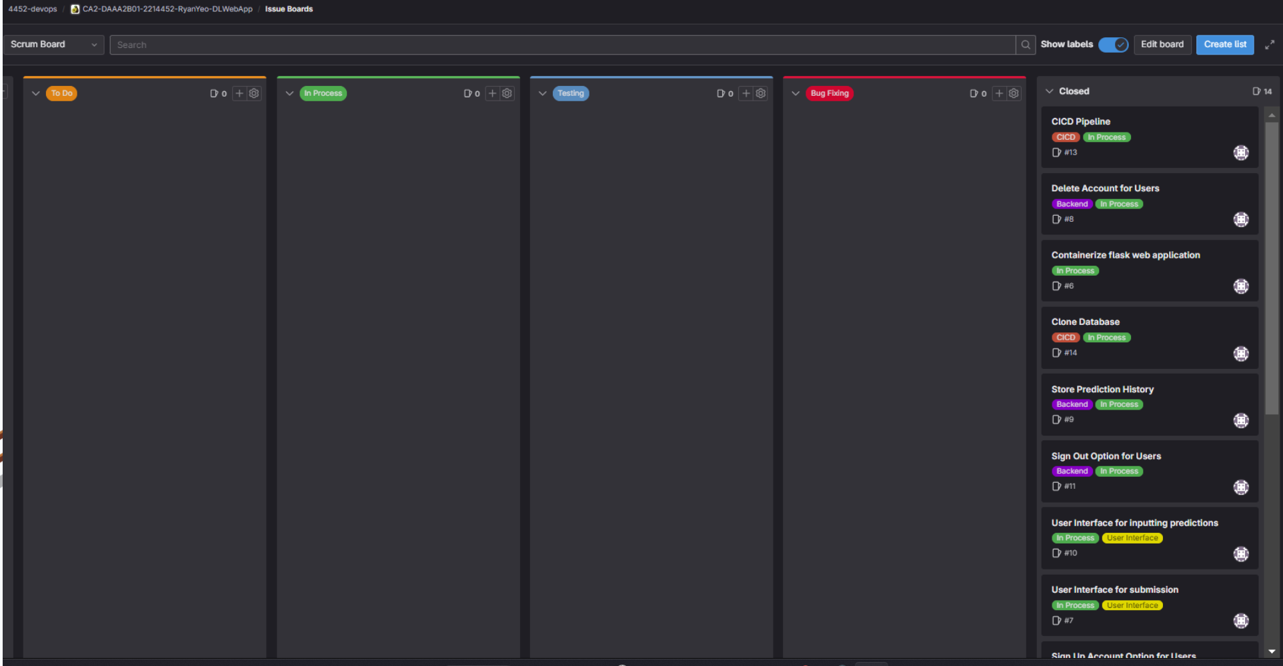
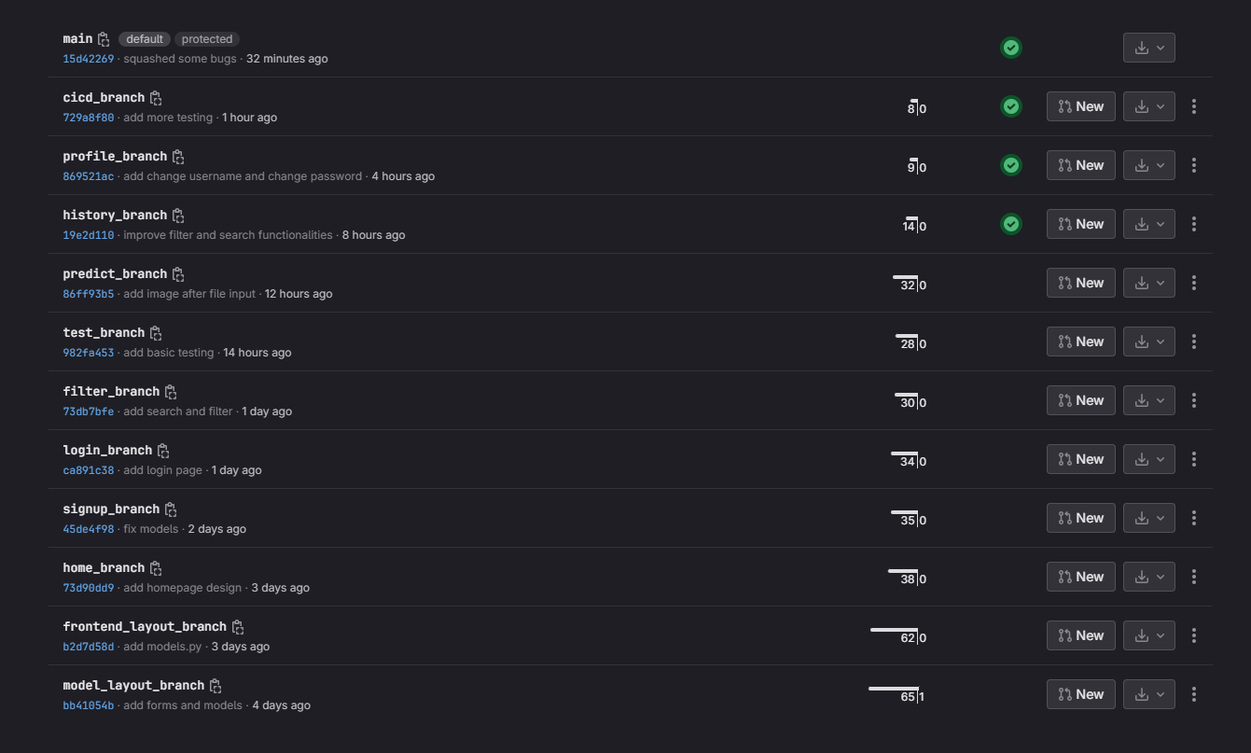
SETTING UP
Use of Scrum Board:
Use of Scrum Board
Helps Keep track of application development
Different sections: To Do, In Progress, Testing & Bug Fixing
Use of Git Branches:
Makes changes to the folder in a controlled environment
Total of 15 branches (3 for Model App, 12 for Web App)

Slide 10
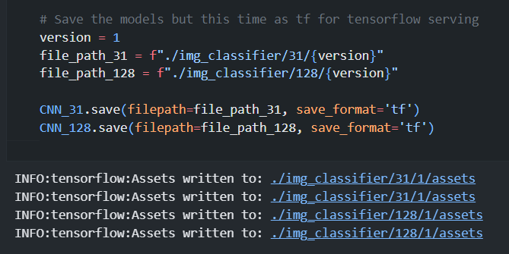
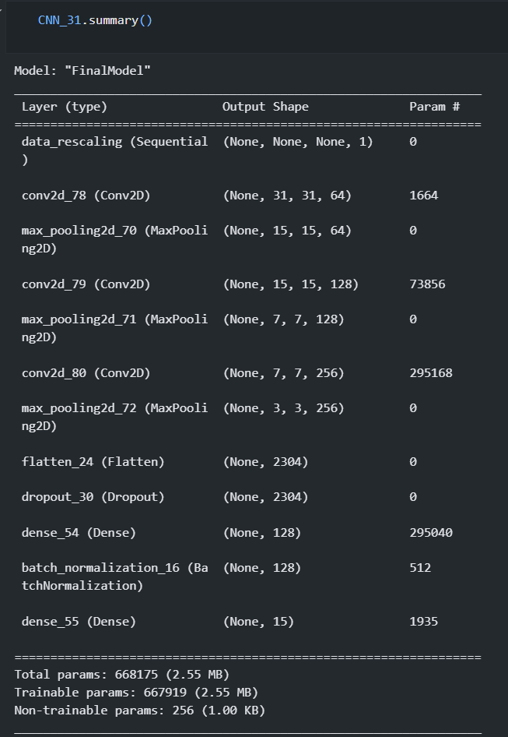
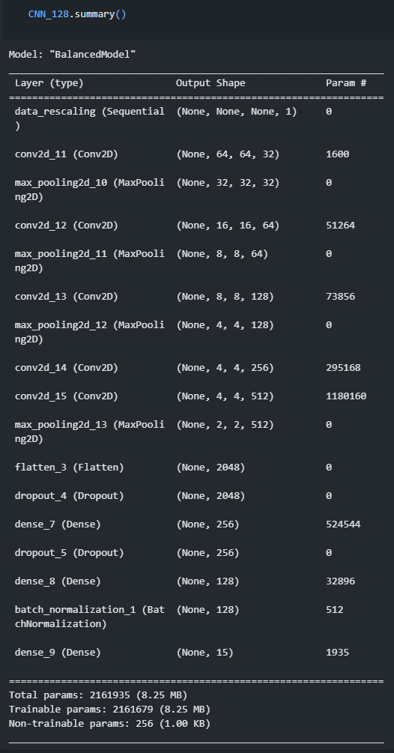
MODEL DEPLOYMENT
Save Models:
Save two models (one handling 31x31 images and another handling 128x128 images) in ‘tf’ format for tensorflow serving

Slide 11
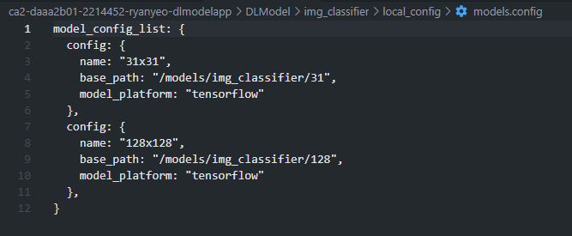
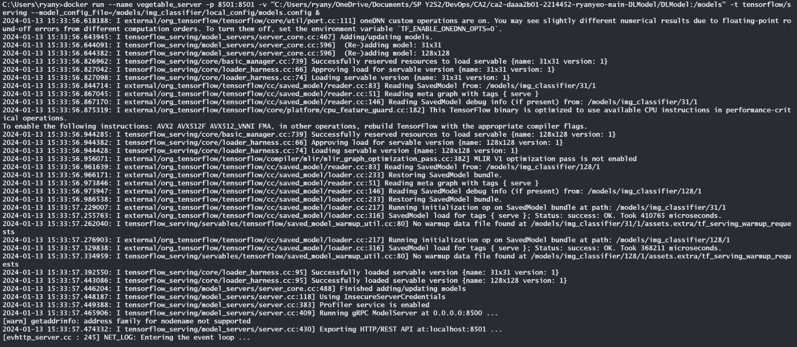
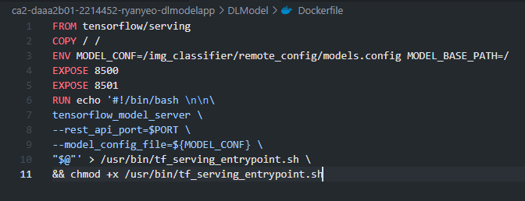
MODEL SERVING
LOCAL DEPLOYMENT:
Before deploying the model on render, test local deployment
Use models.config file to serve both models under the same container
REMOTE DEPLOYMENT:
Similar to Local Deployment
Use of dockerfile instead of running docker in cli
Deploy on render to host the container containing both models

Slide 12
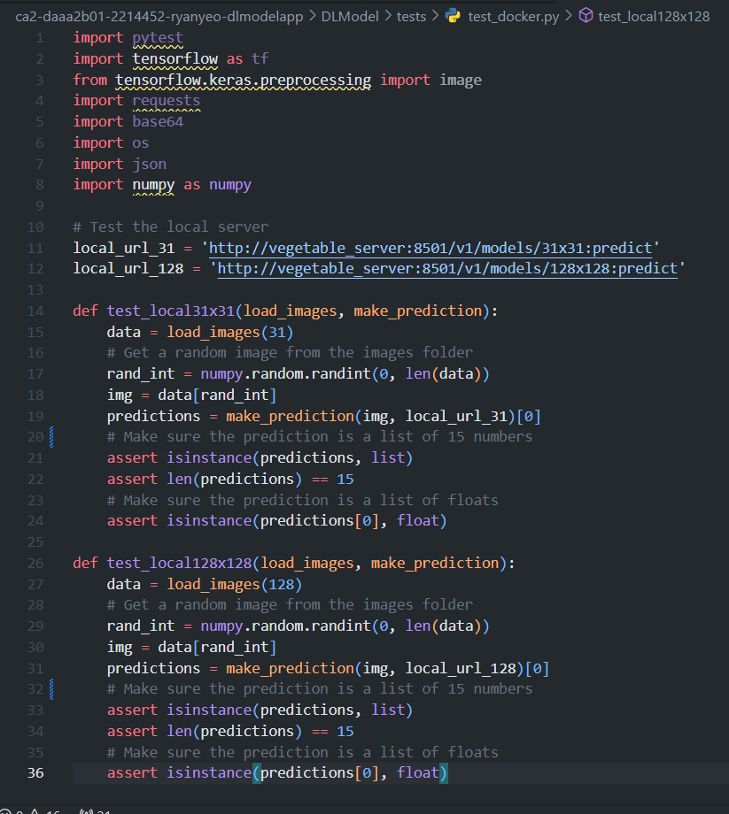
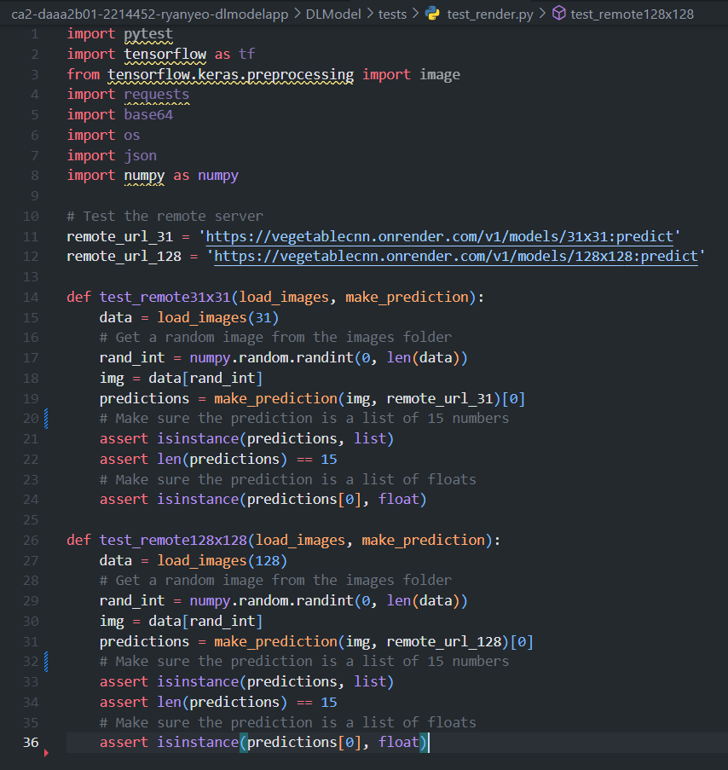
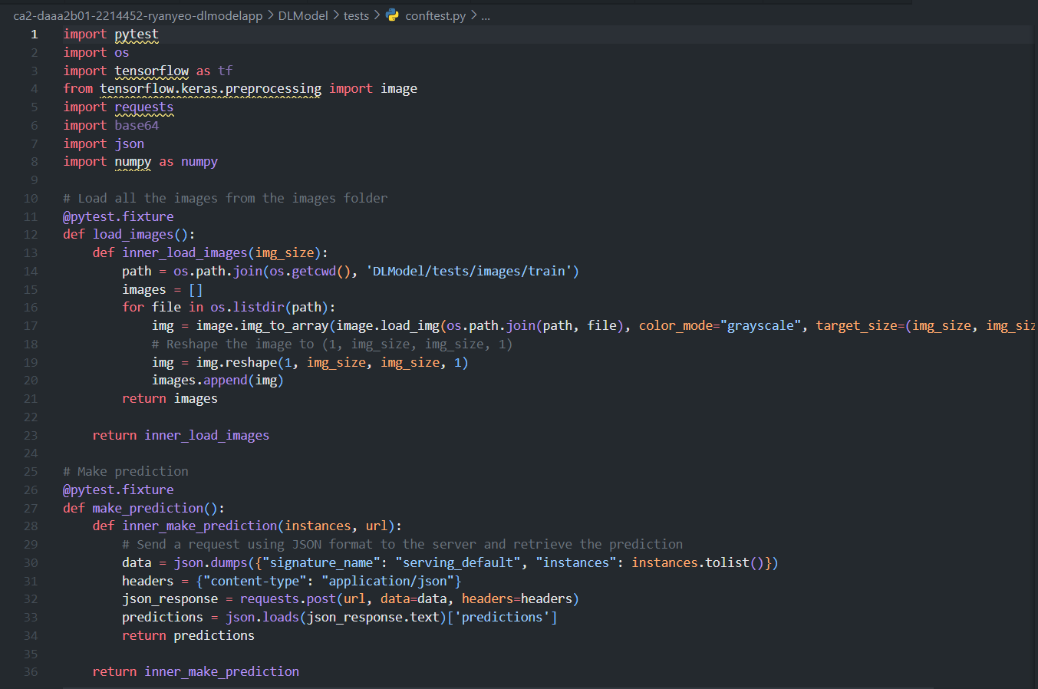
TEST MODEL
TESTING:
Testing includes testing for both local deployment and remote deployment
Test that model returns a list of 15 floats (probabilities)
CONFTEST.PY
Local TEST
REMOTE TEST

Slide 13
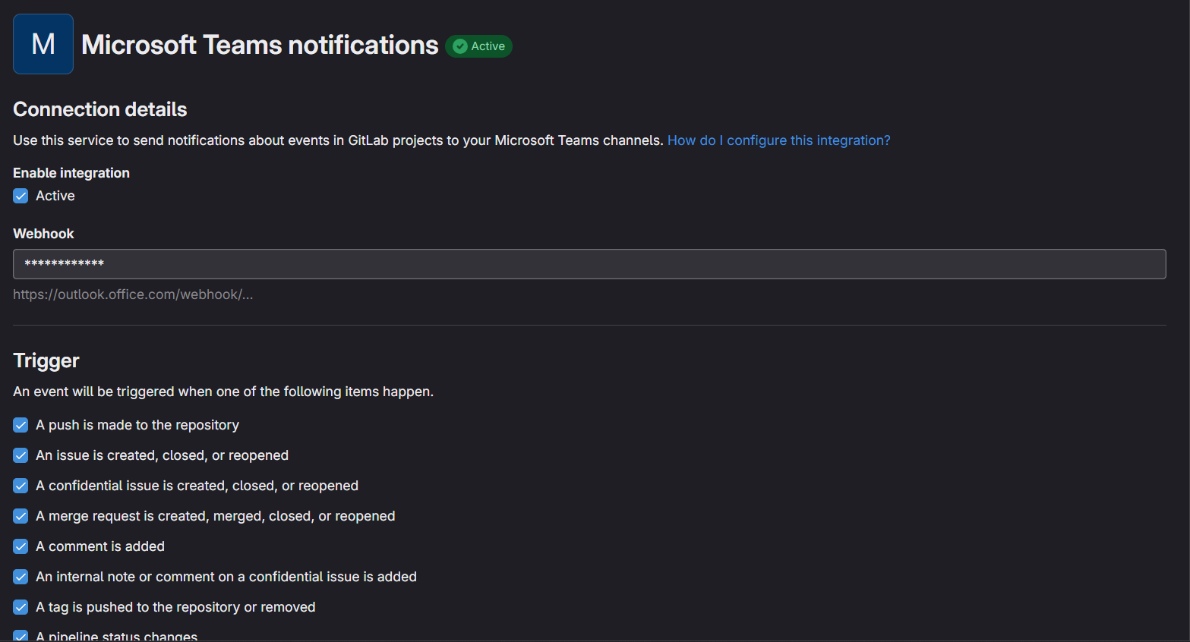
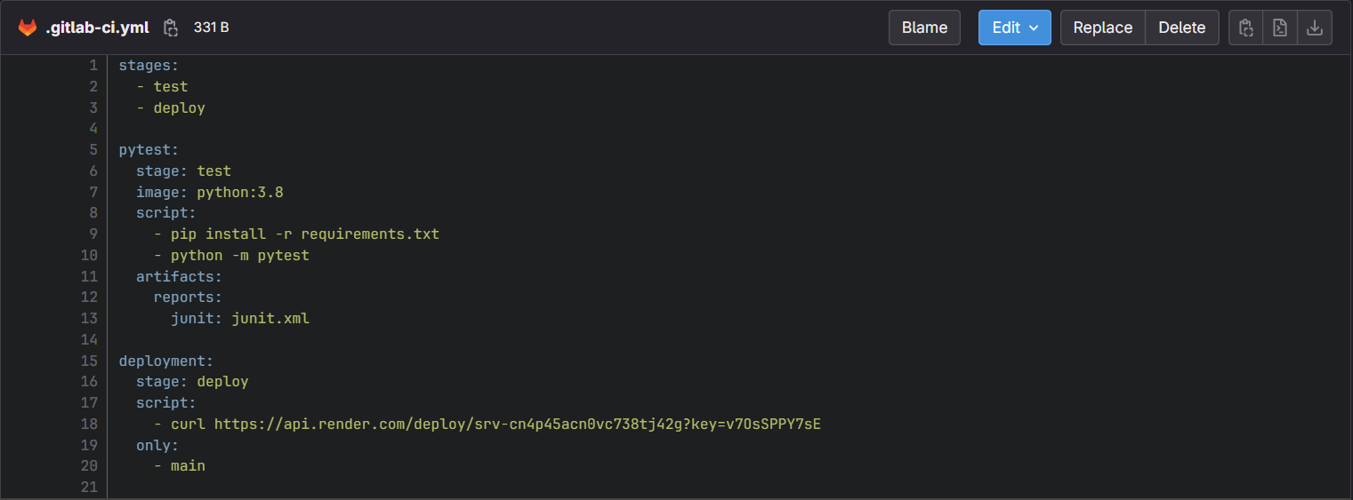
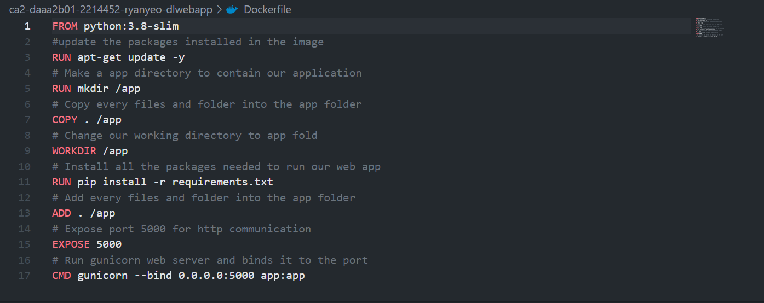
CICD
CICD:
Continuous Integration:
Triggers a series of automated tests when pushed
Sends notification about changes and potential issues when pushed
Continuous Development
Deploys to render when pushed

Slide 14
3.
Testing

Slide 15
REST APIs & Endpoints
Predict:
/api/predict: Get prediction from model
/api/predict/store: Store prediction into db
/api/predict/entries: Get prediction from db
/api/predict/filter: Get filtered prediction from db
/api/predict/remove: Removes prediction from db
User:
/api/user/add: Add user to db
/api/user/login: Logs user into the current session
/api/user/remove: Removes user from db
/api/user/changeuser: Updates a user’s username in db
/api/user/changepw: Updates a user’s password in db
Pages Endpoint:
/
/predict
/history
/profile
/signup
/login
Validity Testing verifies that the software behaves correctly under the various conditions and that it produces
Consistency Testing checks if the software produces consistent results under the same conditions
Unexpected Failure Testing is used to identify any issues or bugs that cause the system to fail in unexpected ways.
Expected Failure Testing is used to verify that the software fails correctly

Slide 16
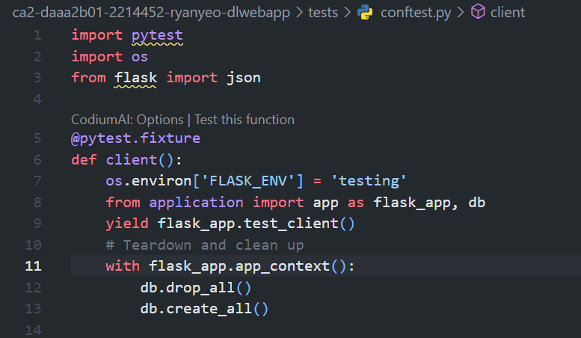
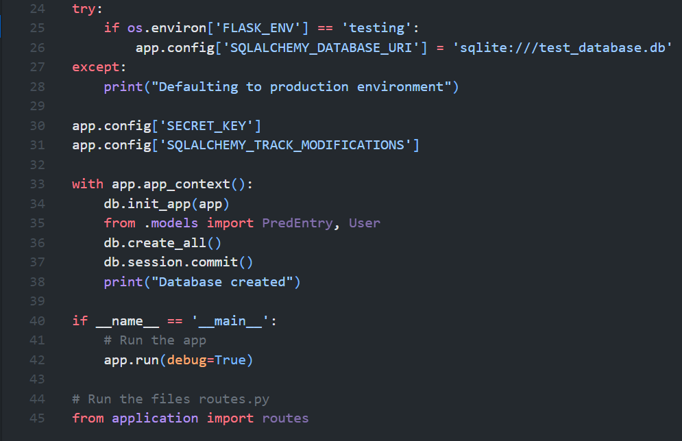
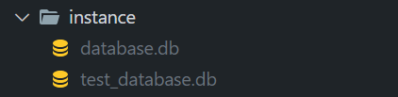
Configure TEST
Clone development db:
Clone development database during testing
Ensures that development db is not affected during testing
Teardown and cleanup after every test
Conftest.py
__init__.py

Slide 17
4.
Advanced

Slide 18

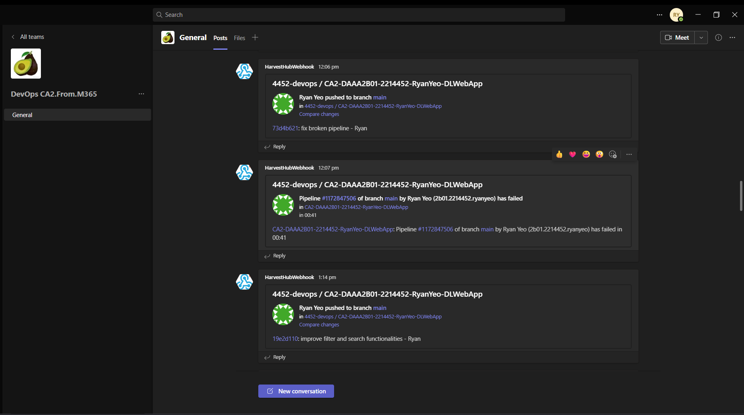

Advanced Feature
UiPath
Notification
Tailwind
Used UiPath for Robotic Process Automation
Integrated Gitlab repository with MSTeams to send a message every time there is a change
Used Tailwind as the main css framework for designing frontend

Slide 19
5.
Robotic Process Automation

Slide 20
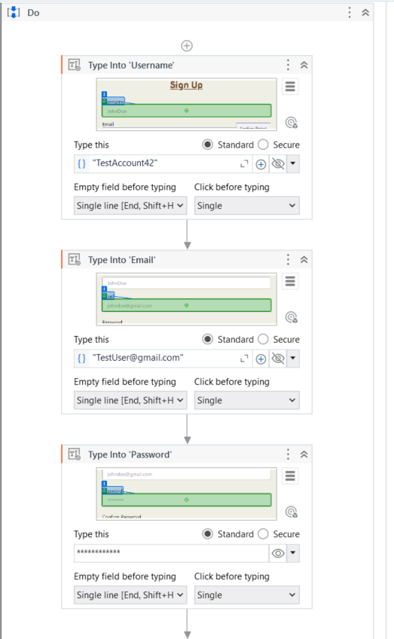
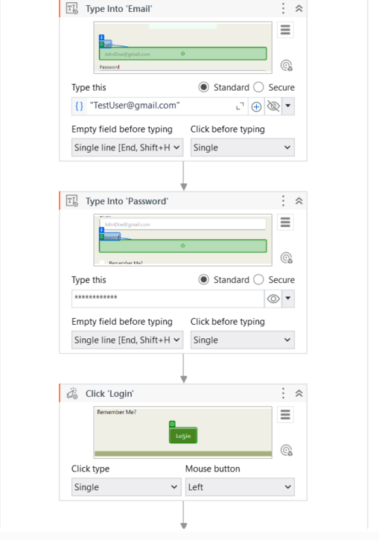
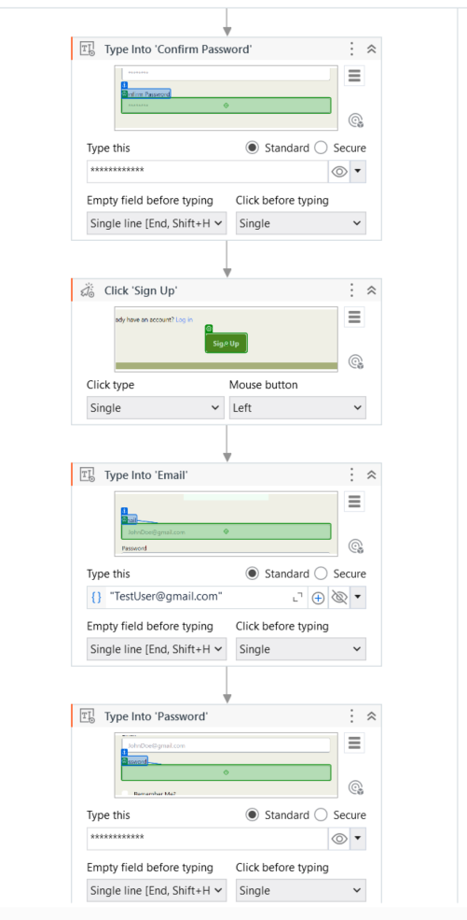
Robotic Process Automation
Testing Using RPA:
RPA helps with automation testing automate repetitive manual testing tasks
For testing, we tested:
Registration
Login
Prediction
using UiPath to automate the form filling and UI interaction processes
Automate LOGIN
Head to registration page and login page
Fill in the form
Automate Registration

Slide 21
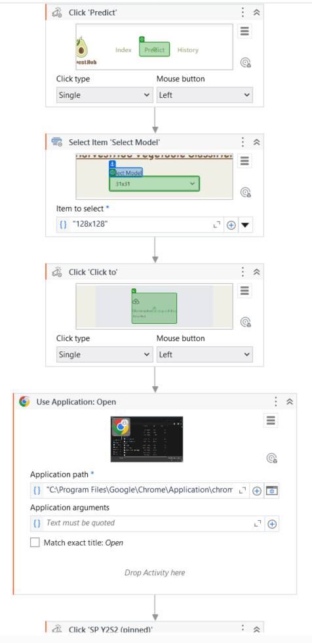
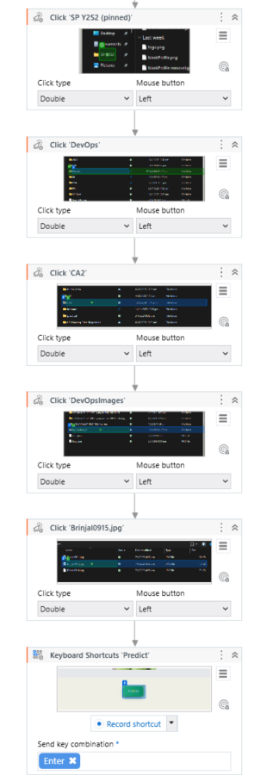
Robotic Process Automation
Head to predict page
Select 128x128 model
Click on Input and select Image using specified file path
Automate Prediction

